Slide 1

RATINGS PREDICTION
Submitted by: Nahid Anjum Gouri

Slide 2
Problem Statement
We have a client who has a website where people write different reviews for technical products. Now they are adding a new feature to their website i.e. the reviewer will have to add stars(rating) as well with the review. The rating is out 5 stars and it only has 5 options available 1 star, 2 stars, 3 stars, 4 stars, 5 stars.
Now they want to predict ratings for the reviews which were written in the past and they don’t have a rating. So, we have to build an application which can predict the rating by seeing the review.
Ratings Prediction: We have to predict ratings of all the products based on the reviews given by customers which will be pre-processed and trained.

Slide 3
Analytical Problem Framing
Data Collection Phase
We have to scrape the reviews of different laptops, Phones, Headphones, smart watches, Professional Cameras, Printers, monitors, Home theater, router from different e-commerce websites. Basically, we need these columns:
1) reviews of the product.
2) rating of the product i.e., 1,2,3,4,5

Slide 4
Firstly we have collected data from Amazon and Flipcart. We made two different dataframes and concate those. For balancing data we take equal amount of rating

Slide 5


Data Pre-Processing
The data is that we saved in csv format we imported it using pandas and to further proceed with the pre-processing steps.

Slide 6
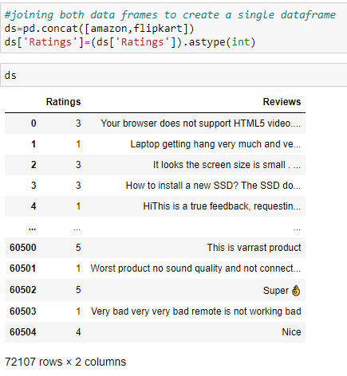
Concatination of both dataframe

Slide 7
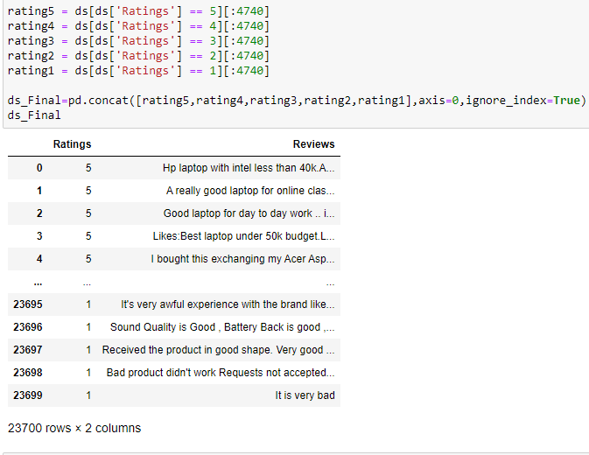
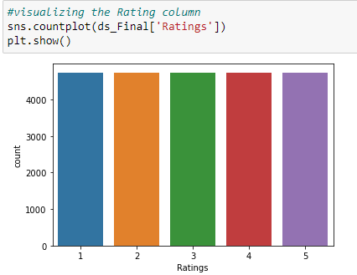
Rerranging Dataframe to avoide data imblancing problem:

Slide 8
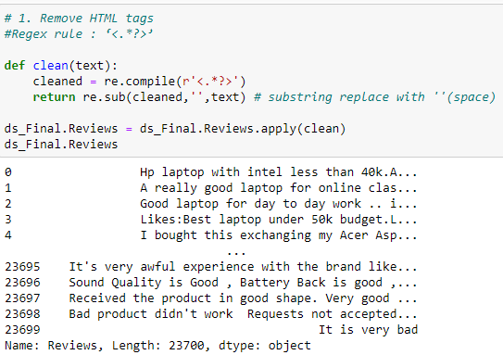
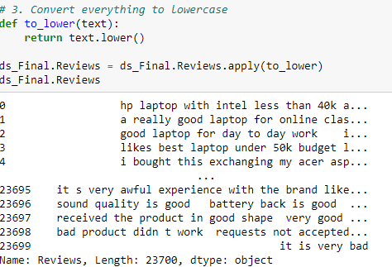
Data cleaning such as removing html tags, web address, stopwords etc.

Slide 9
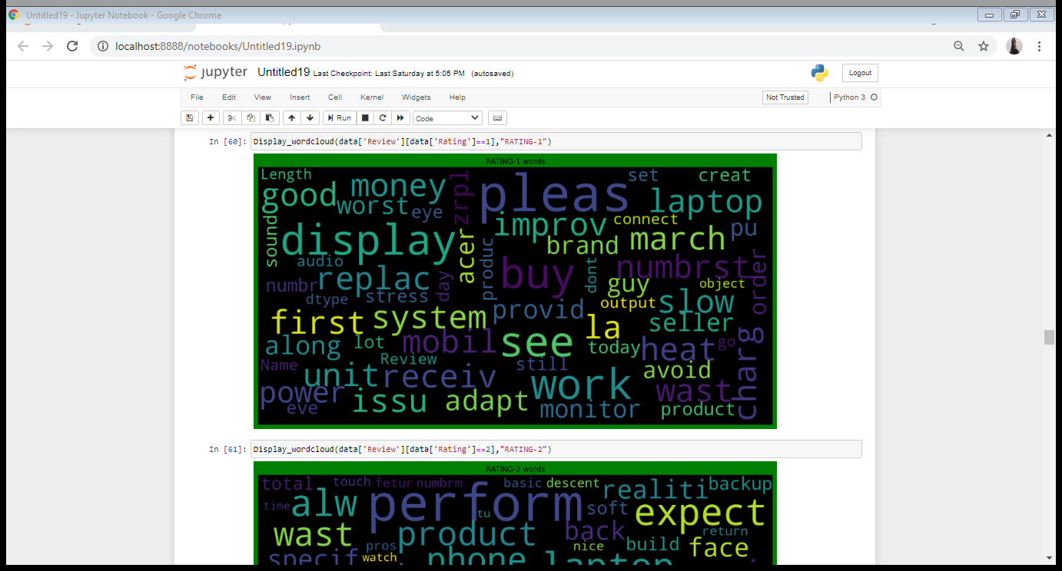
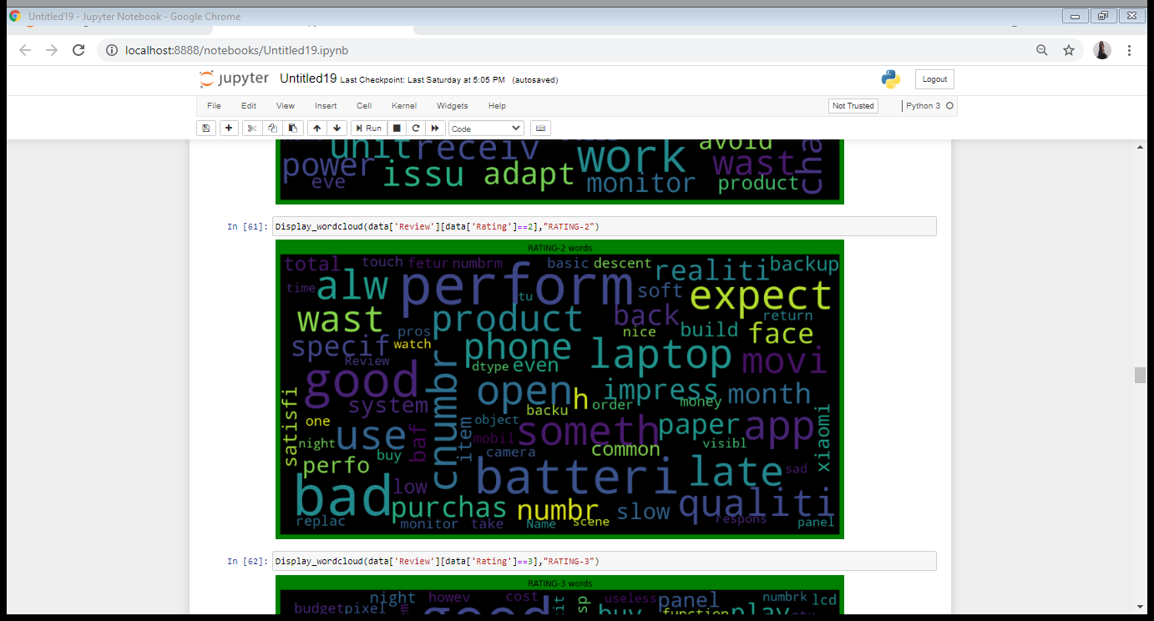
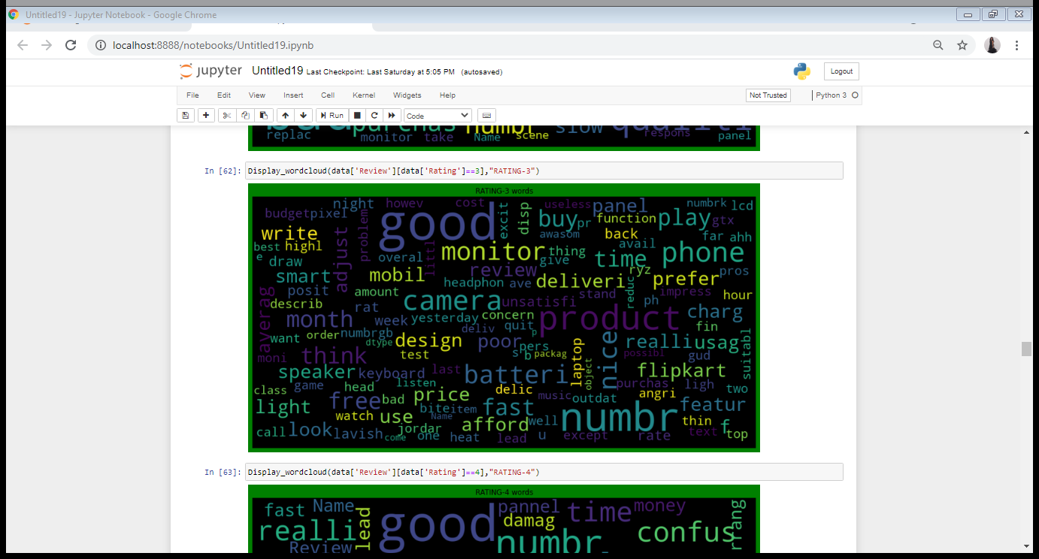
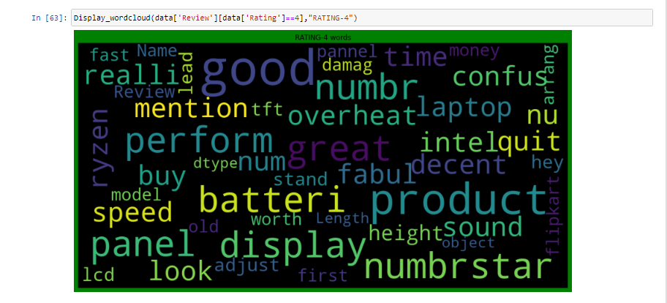
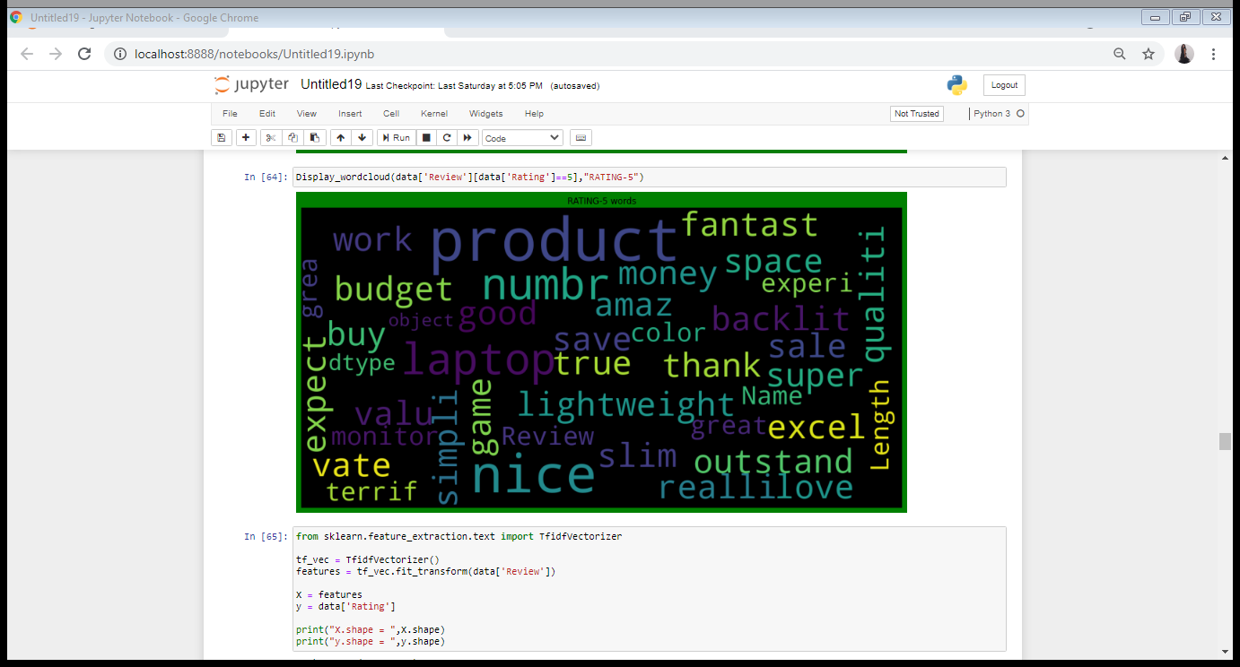
To get sense of loud words in Review corresponding to each rating i., 1, 2, 3, 4 and 5 we have used wordcloud and visualized it as follows:

Slide 10
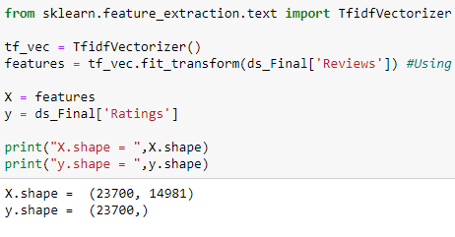
Model/s Development and Evaluation
Review column have been converted to tokens using TFidfVectorizer. Then using train_test_split we split the data into training and testing dataset.
We have used following algorithms such as: RandomForestClassifier, AdaBoostClassifier, MultinomialNB, DecisionTreeClassifier and KNeighborsClassifier.

Slide 11
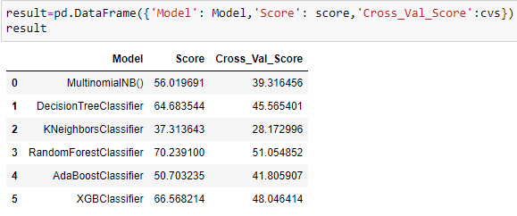
Key metrics used for finalising the model was accuracy_score, cross_val_score. Since in case of RandomForestClassifier it was giving us maximum score among all other models and it's performing well. It's cross_val_score is also satisfactory and it shows that our model is neither underfitting/overfitting.

Slide 12
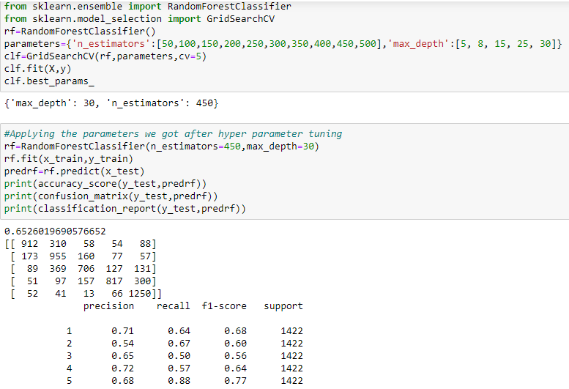
Since RandomForestClassifier was giving us maximum score we applied hyper parameter tuning on it to further improve the result using GridSearchCV.

Slide 13
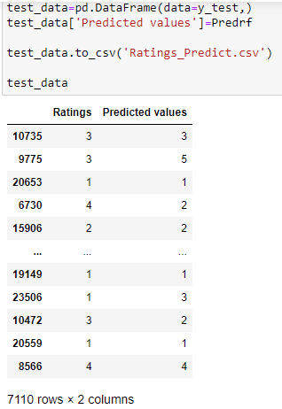
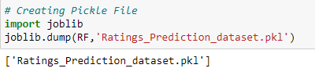
We will further use that model to predict our test data set as follows:

Slide 14
Conclusion
We got 70% accuracy score with RandomaforestClassifier.
We had to go through multiple source of data in order to balanced dataset.
We can use this model for predicting customers inclination for future use.

